Slide 1

TOC
Barrier

Slide 2
Barrier

Slide 3
Purpose:
The Barrier class provides a mechanism for synchronizing multiple threads or tasks at a specific point in their execution. It allows you to create a barrier that multiple threads can wait on, and then release all waiting threads at once when a specified number of threads have reached the barrier. This is useful for scenarios where you need to ensure that all threads have completed a certain step before proceeding.

Slide 4
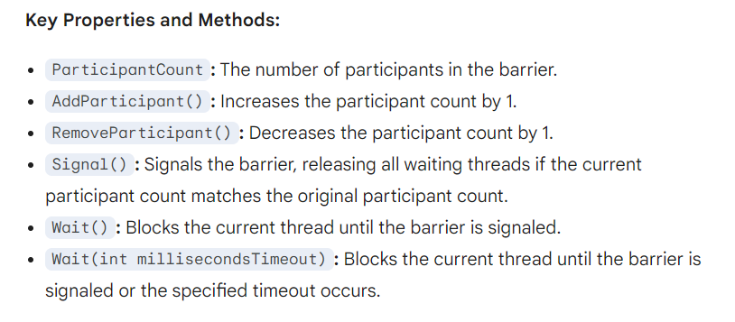

Slide 5
Another Example: Parallel Image Processing
Scenario: A large image processing application that needs to process different regions of an image in parallel. However, certain processing steps require the results from other regions, so synchronization is necessary.

Slide 6
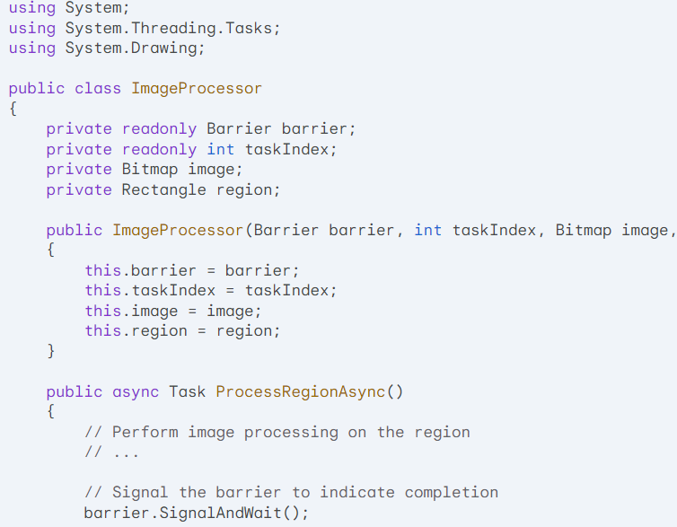

Slide 7
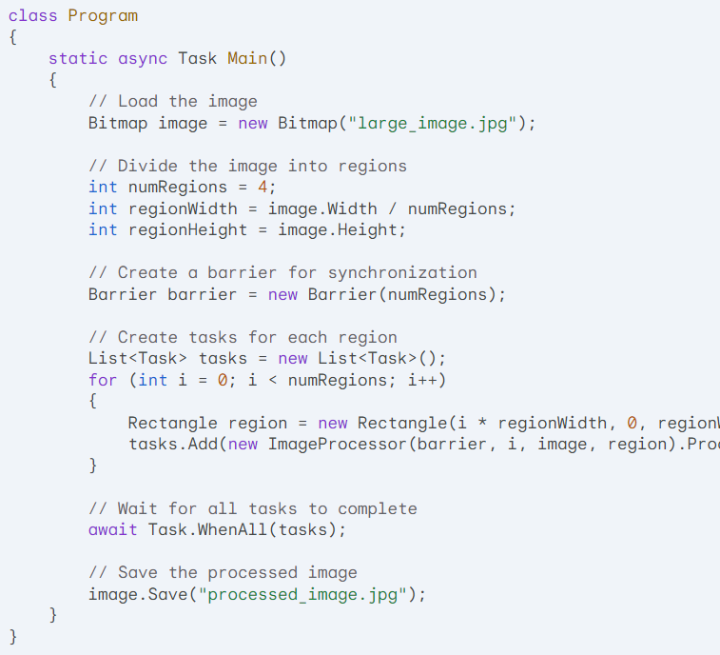

Slide 8
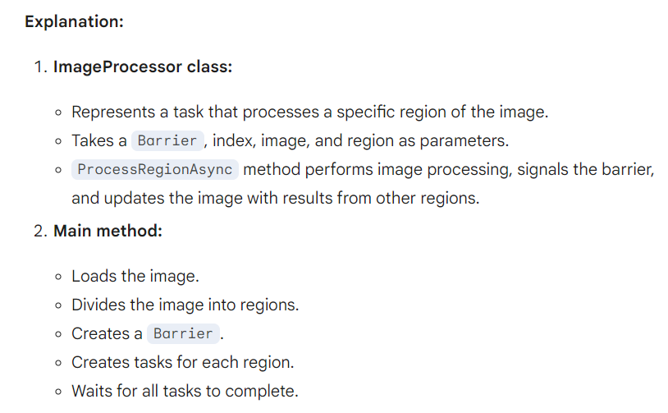

Slide 9
Key points:
The Barrier ensures that all regions have been processed before updating the image with the results from other regions.
This approach allows for efficient parallel image processing while maintaining the correct order of operations.
The Barrier can be used in various image processing scenarios, such as edge detection, filtering, and feature extraction.

Slide 10
CountdownEvent:
Purpose: Used to coordinate multiple threads or tasks based on a specified count.
Mechanism: Tracks a count and signals all waiting threads when the count reaches zero.
Use cases:
Waiting for multiple asynchronous operations to complete before proceeding.
Implementing a "cancellable" operation where a certain number of tasks must finish before cancellation is allowed.
Barrier:
Purpose: Used to synchronize multiple threads or tasks at a specific point in their execution.
Mechanism: Creates a barrier that all participants must reach before proceeding.
Use cases:
Implementing parallel algorithms where multiple threads must wait for each other at specific points.
Coordinating multiple stages of a pipeline or workflow.

Slide 11
Key differences:
Count vs. Participants: CountdownEvent tracks a count, while Barrier tracks participants.
Signal mechanism: CountdownEvent can be signaled multiple times, while Barrier is typically signaled only once per participant.
Wait behavior: CountdownEvent waits for the count to reach zero, while Barrier waits for all participants to reach the barrier.

